Slide 1
Goodie Foodie App
By Team 28:
Elam He
Hsin Yu Ivy Tsai
Hui Qiu
Chan Shum Loman
Tung Po Alex Tsang

Slide 2
Intro to the Team
Love homemade food
Enjoy cooking
Want to make cooking an easy task for everyone
Realize many ppl don't know how or what to cook

Slide 3
Project Description
Share and exchange cooking tips and look up recipes
Search recipes
Share posts, like or leave comments
Track ingredient's expiration dates
Online grocery shopping available

Slide 4
Project Vision – Positioning
Business Opportunity:
Homemade food
Help decide what to cook
Improve cooking skills
Problem Statement Solution:
A free mobile app that could generate a list of recipes
Product Position Statement:
For those that prefer homemade food
Product includes search recipes, share posts, track expiration dates, and online grocery shopping

Slide 5
Project Vision – Stakeholder and User
Stakeholders:
Software Developer
Project Manager
System Analyst
Technical Reviewer
System Administrator
Database Administrator
Supermarket Owner
Students (User)
Users:
Supermarket Owner
Students (User)
Delivery Person
Customer Service

Slide 6
Project Vision – System Features
Send ingredients' expiration date notification
Search recipes by preferences
Post, share, comment and like contents for user interactions
Order ingredients from grocery store or supermarket online
Grocery stores uploading goods information when put on sale
Track delivery status for online orders

Slide 7
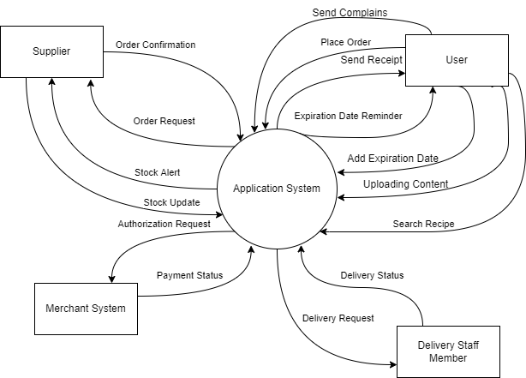
High Level Requirement -Requirement Scope Area

Slide 8
High Level Requirement - External Entity
Delivery Staff Member : Deliver the goods ordered by Users.
Suppliers : A grocery store that provides ingredients and delivery services to another entity
User : Services in the app
Merchant System (eService) : Electronic payment of credit card processing.

Slide 9
High Level Requirement - Information Flows
Search Recipe
Authorization Request
Payment Status
Order Request
Confirm Order
Stock Alert
Stock Update
Expiration Date Reminder
Adding Expiration Date
Uploading Content
Send Complaint
Send Receipt
Place Order
Delivery Status

Slide 10
Project Plan - Deliverables
Generate Recipe
Send Notification
Create, edit, and delete post
Comment and like post
Add item to cart/checkout
Receive digital receipt
Track ingredients' expiration date

Slide 11
Project Plan - Assumptions
Users can input ingredients and a list of recipes will be shown to the screen
Users can create or view post
Users can keep track of the ingredients they have in their kitchen
Users can do online grocery shopping
Users can do online transactions and receive their digital receipt
Users can check the delivery status of their order
Suppliers would be notified if their inventory is low
Suppliers can see orders placed by users

Slide 12
Project Plan - Constraints/Risks
Copyright issues for using recipes
Ingredient are delivered to the wrong address
The posted content may not be relevant or appropriate to our application
The ingredients users bought online may not be fresh
User personal information might be hacked

Slide 13
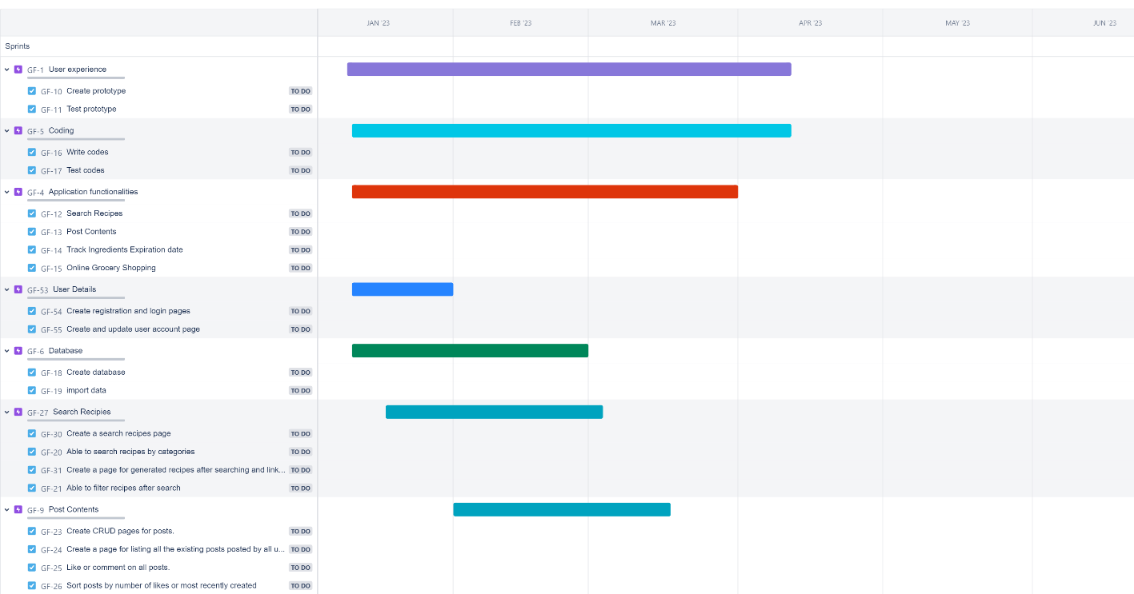

Slide 14
Team Charter
Team Empowerment:
Knowledge and Skills
Interpersonal Skills
Problem-Solving Skills
Team Operation:
Team Meeting
Decision Making
Team Communication
Team Performance Assessment:
Attendance
Responsibility
Collaboration
Time Management

Slide 15
Conclusion
Next Steps:
Collect requirements
Create data models

Slide 16
Thank You!

